Slide 1
Photomicrographs of Plant foods
Asparagus
Permission to reproduce original photomicrographs used to make this collection may be obtained from
Dr. David O. Norris at
david.norris@colorado.edu

Slide 2
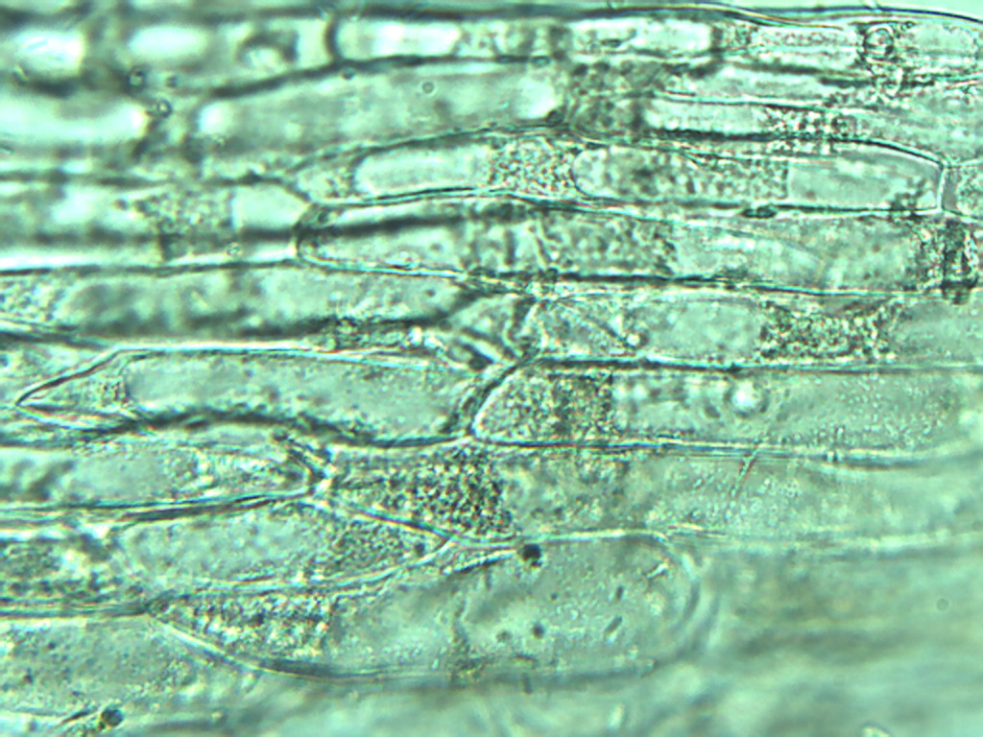
Notes:
20. Asparagus officinalis L. Asparagus. Epidermal cells, 40X

Slide 3
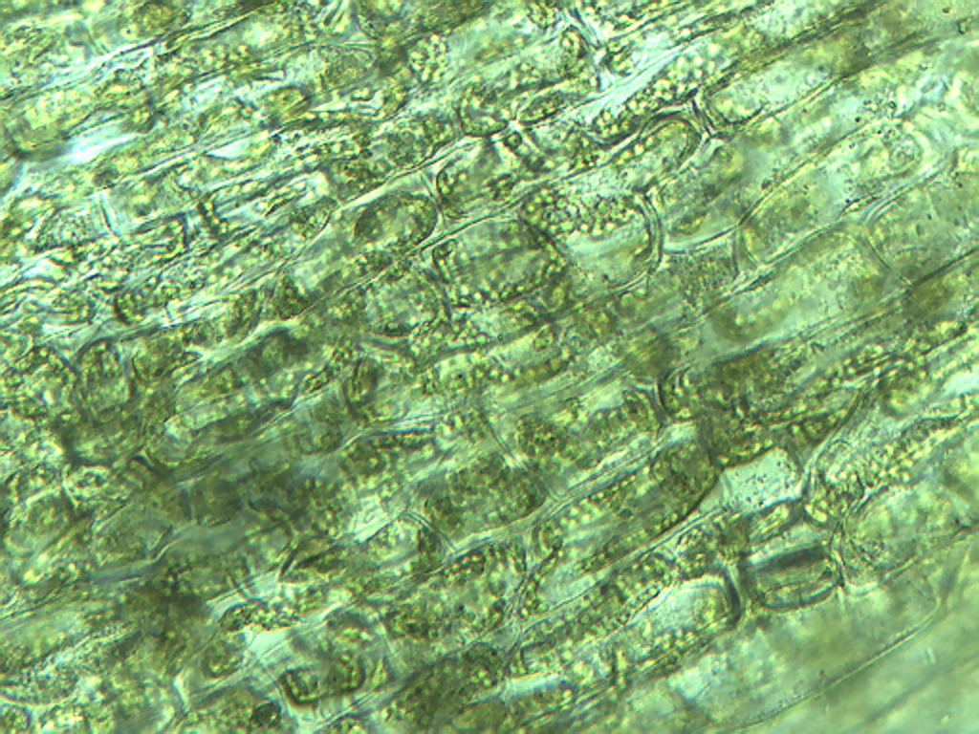
Notes:
21. Asparagus. Photosynthetic parenchymal cells, 25X. Note circular chloroplasts (arrows).

Slide 4
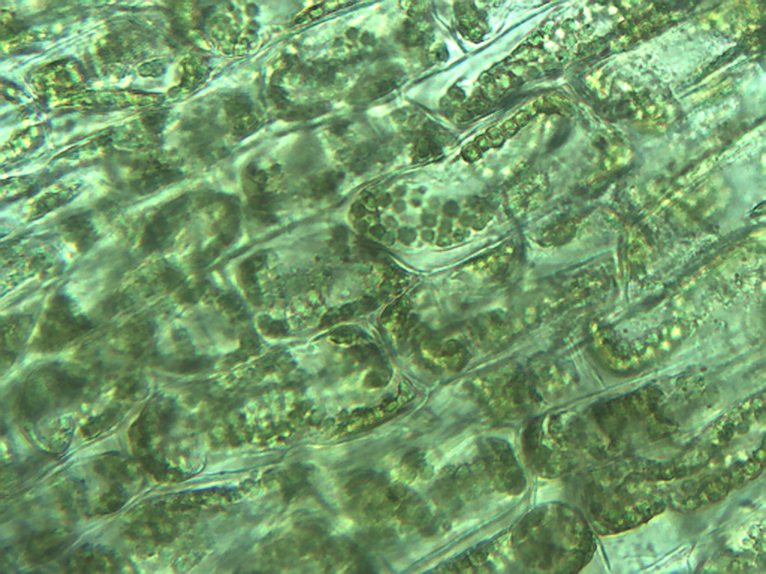
Notes:
22. Asparagus. Photosynthetic parenchymal cells, showing chloroplasts (arrows), 40X.

Slide 5
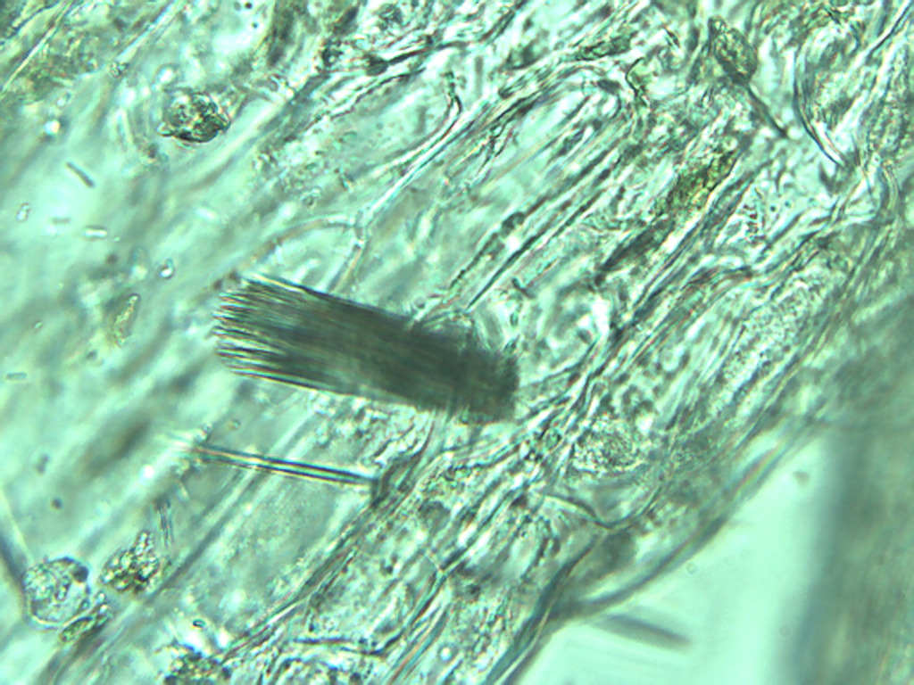
Notes:
23. Asparagus. Bundle of raphide crystals, 40X.

Slide 6
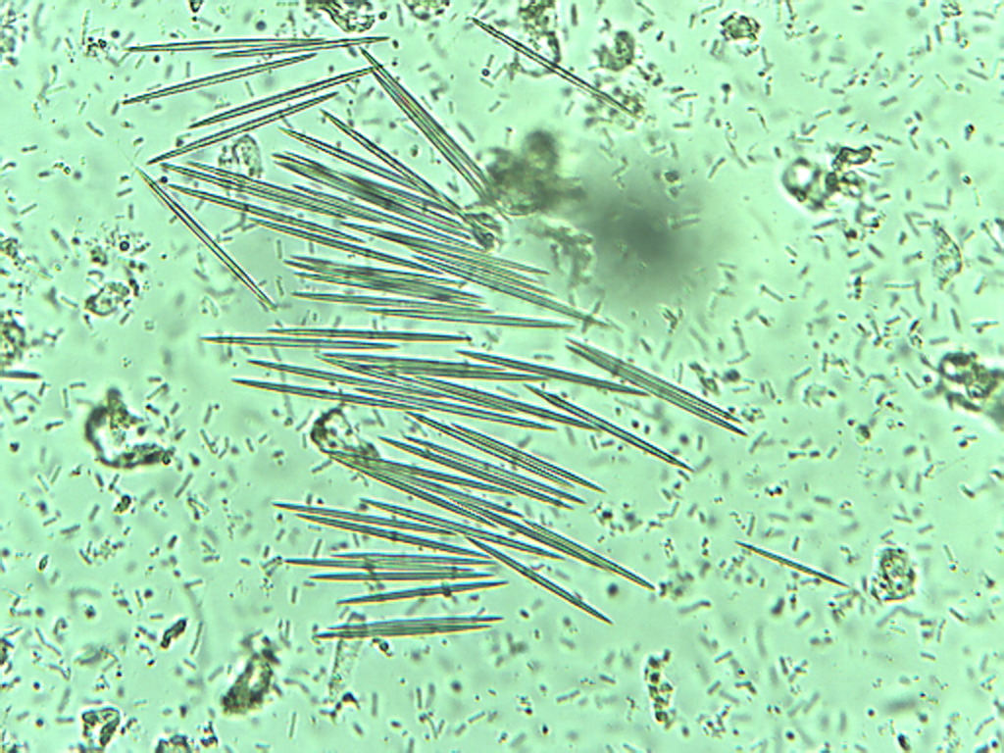
Notes:
24. Asparagus. Free raphide crystals, 40X

Slide 7
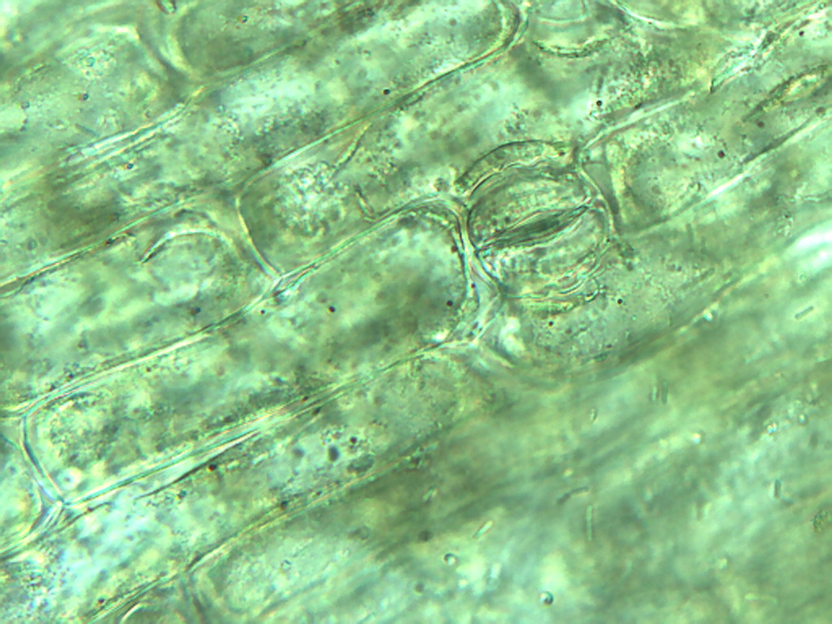
Notes:
25. Asparagus. Stomate (arrow) among epidermal cells, 40X.

